Slide 1
DJango
Dr.Balwinder Kaur

Slide 2
Introduction
Django is a high level python framework.It is free and open source ,written in python itself and follows the model-view-template architectural pattern.
we can use it to develop quality web applications faster and easier.Since developing for the web needs a set of similar components,you can use a framework.

Slide 3
This way ,you don’t have to reinvent the wheel.These tasks include authentication,forms,uploading files,management panels and so on.

Slide 4
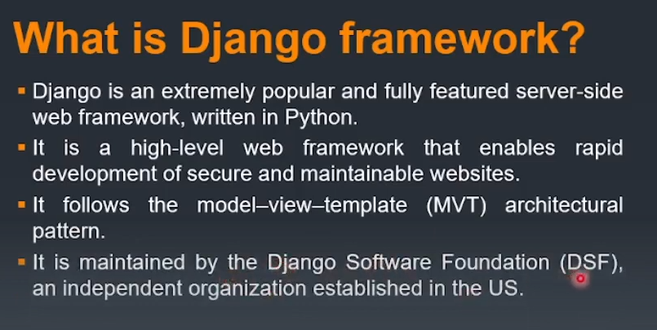
DJango

Slide 5
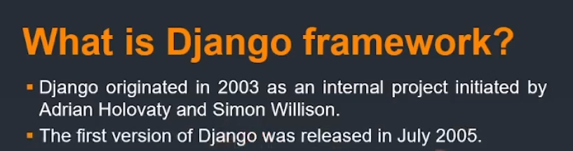
Django

Slide 6
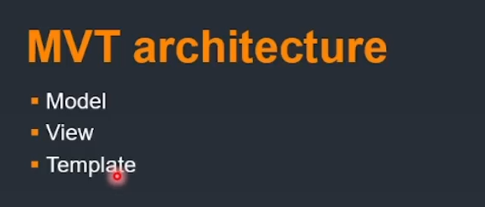
MVT Architecturre

Slide 7
MVT Architecture
Models-Just like the model in MVC ,here as well it has the same functionalty of providing the interface for the data stored in the database.This also help in simplifying the interaction with the database.you can create a class that will help you to create a table and fields in the database.
Views-In Django views act as a link between the Model data and the Templates.It sees the user request,retrieves appropriate data from the database,then renders back the template along with the retrieved data.In short,it receives request and reflects response.

Slide 8
Templates-Just like view in MVC,Django uses templates in its framework.Templates are responsible for the entire user interface completely.It handles all the static parts of the webpage along with the HTML,which the users visiting the webpages will precieve.It is nothing but an html file which is mixed with some kind of syntax that is used in Django also called as Django template Language.This allows you to dynamically generate content based on the data that is sent from the view.

Slide 9
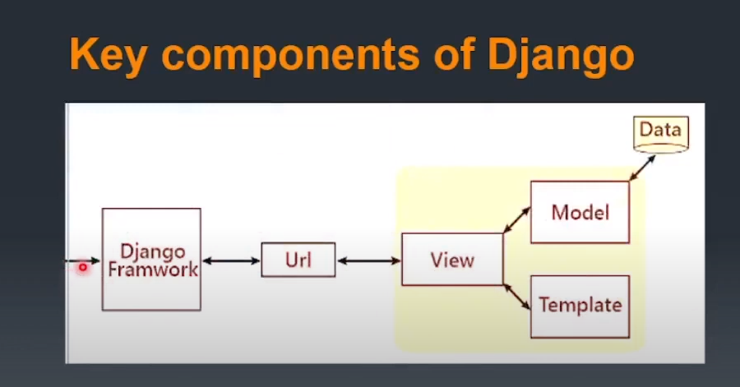
Components

Slide 10
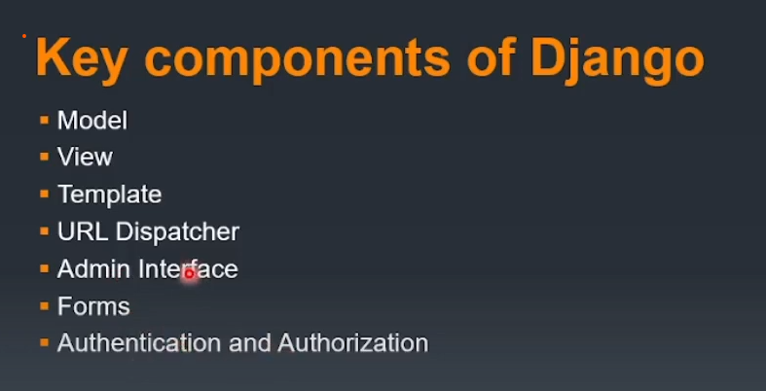
Components

Slide 11
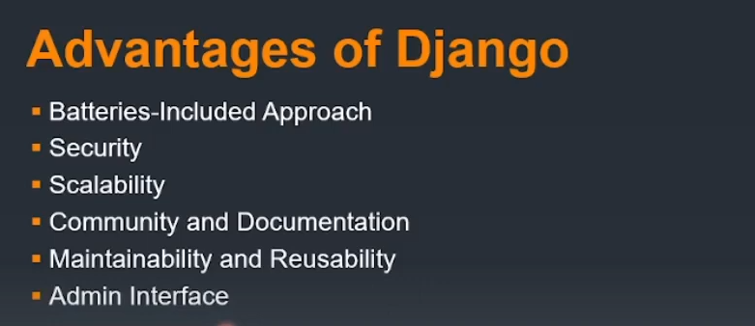
Advantages

